Slide 1
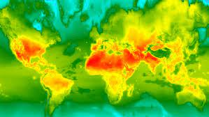
Spatial Data Science In Python: (Crop Detection)

Slide 2
Who we are
Wanjohi Christopher
-Data Scientist @Serix
-AWS Community Builder
.
Nicholas Musau
Data Science & Spatial Consultant,
Business Performance and Product Analyst (FBL),
AWS Community Builder.

Slide 3
Spatial Data Science
Spatial data science (SDS) is a subset of Data Science that focuses on the unique characteristics of spatial data, moving beyond simply looking at where things happen to understand why they happen there.
SDS treats location, distance & spatial interactions as core aspects of the data using specialized methods & software to analyze, visualize & apply learnings to spatial use cases.

Slide 4
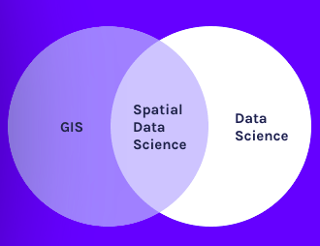
.
.

Slide 5
Why Spatial DS Matters
- It enhances performance, ease weighted decisions and allows more accurate analysis.
- It inspires a greater spectrum of applications because of data accuracy- better precision leading to increased productivity.
Geospatial technologies enhance the performance of AI in the industry
The development of geospatial technologies initiates a corresponding upgrade of related industries.
Improvement process is not likely to stop, thus ensuring even greater precision, credibility, performance, quality, and security.

Slide 6
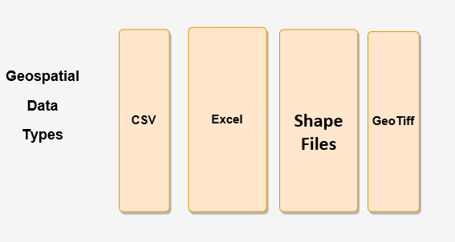
Datasets in Spatial Analysis

Slide 7
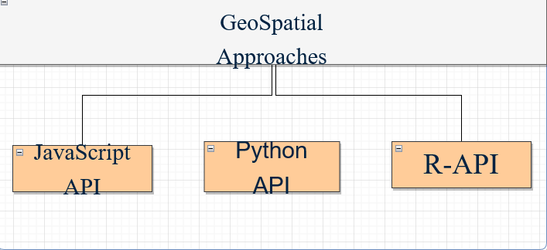
GeoSpatial Approaches

Slide 8
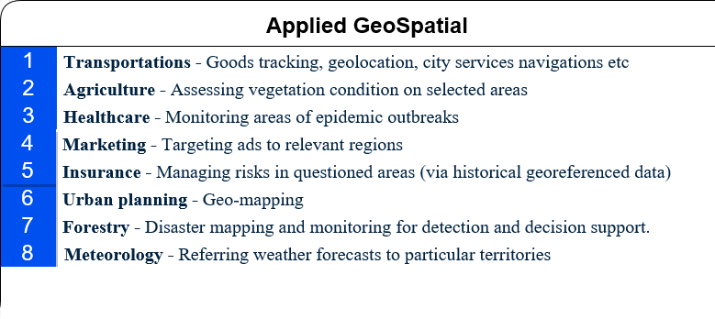
.

Slide 9
Key Components
Feature- is an object with a geometry property storing a Geometry object (or null) and a properties property storing a dictionary of other properties.
FeatureCollection- Groups of related features combined.
Image-Images are composed of one or more bands and each band has its own name, data type, scale, mask and projection.
ImageCollection-A Stack of images collected by a specific sensor-Landsat, NOAA, COPERNICUS, Sentinel….

Slide 10
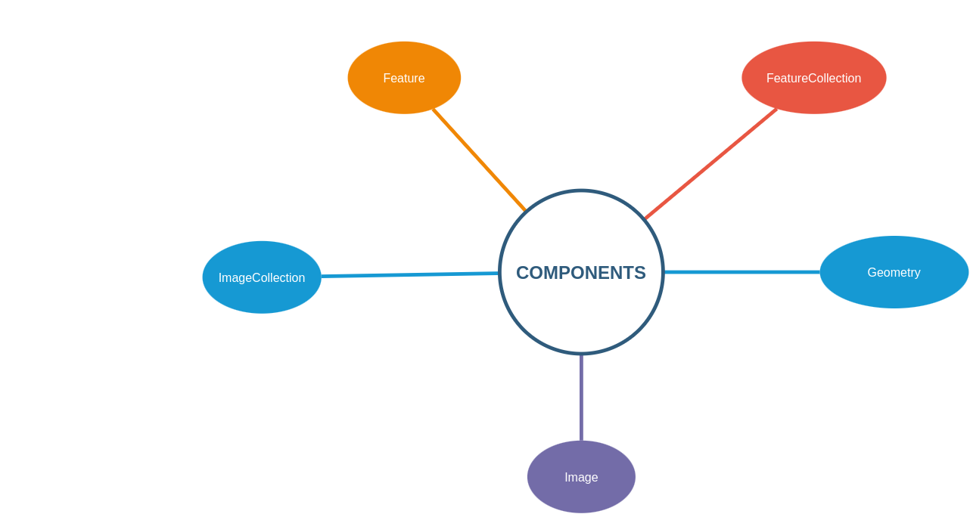
Key Components

Slide 11
.
Cloud removal
Resampling and Resolution Reduction
Cloud masking
Reduce regions
Bound filtering
Band selection
Date filtering

Slide 12
GeoSpatial AI Algorithms
ML Algorithms
Supervised classification ee.Classifier
Unsupervised ee.Clusterer
TensorFlow model- ee.Model
Specialized Algorthms
Landasat Algorithms
Sentinel-1 Algorithms
Accuracy Assessment Techniques
Confusion Matrix

Slide 13
Challenges
Spatial-temporal dependence estimation is computationally expensive- data querying and analysis.
Limited open source contribution
- Expensive learning resources
- Data mining techniques, (where, how and when)
- Scarce Spatial analysis skills

Slide 14
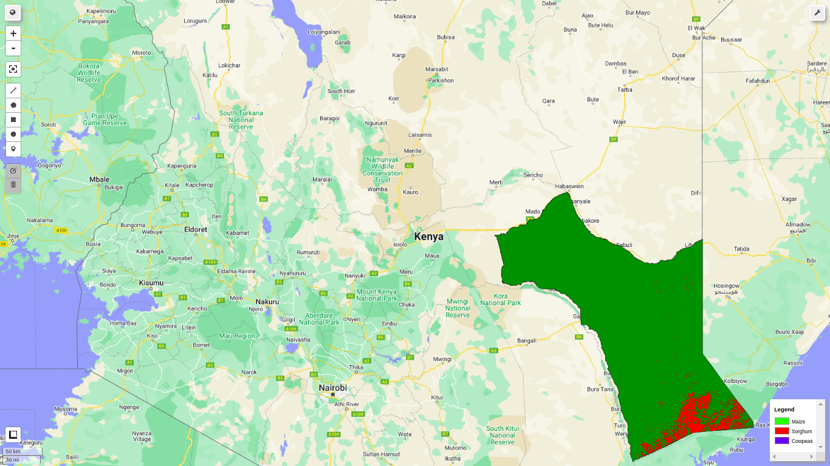
Hand on Demo

Slide 15
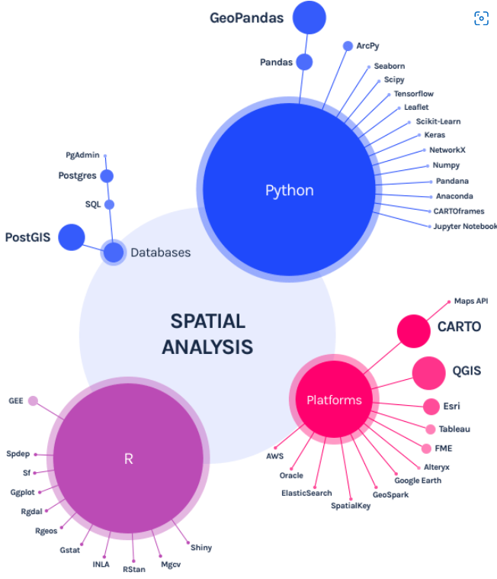
Recap
.

Slide 16


Follow us on
Email: nichmsau@gmail.com
LinkedIn: Nicholas Musau
Twitter: @nich02
Email: christophermyaga411@gmail.com
LinkedIn: Wanjohi Christopher
Twitter: @IamWanjohichris
Github: WanjohiChristopher

